Slide 1
Analyzing Health Equity Using Household Survey Data
Lecture 19
Health Care Payments and Poverty

Slide 2
Poverty measures overlook individuals made poor by health payments
OOP health payments can drive individuals into poverty
Standard poverty measures do not adequately account for health needs
How to measure poverty taking account of OOP health payments?
How many more individuals are identified as poor when poverty is assessed on basis of household resources net of OOP payments?
Notes:
In the previous lecture we examined the issue of catastrophic payments for health care—the disruption to material living standards due to large out-of-pocket (OOP) payments for health care in the absence of adequate health insurance coverage. In the extreme, OOP payments could lead to poverty. This is not reflected in standard methods of measuring poverty, which compare total household expenditure with a poverty line that is not sensitive to highly variable health care needs. A household that at times of illness diverts expenditure to health care to an extent that its spending on basic necessities falls below the poverty threshold will not be counted as poor. Nor will a household that lives below the poverty threshold but borrows to cover health care expenses such that its total expenditure is raised above the poverty threshold. It has been estimated that 78 million people in Asia are not currently counted as poor despite the fact that their per capita household expenditure net of spending on health care expenditure falls below the extreme poverty threshold of $1 per day (van Doorslaer et al. 2006).
In this lecture we describe and illustrate methods to adjust measures of poverty to take into account spending on health care. In essence, this involves the measurement of poverty on the basis of household expenditure net of OOP spending on health care.

Slide 3
Assessing poverty on basis of household resources net of OOP payments
Justified if OOP payments are in response to basic needs not reflected in poverty line
Heterogeneity and unpredictability of health needs makes it difficult to adjust poverty line for them
Not all OOP payments are nondiscretionary, so subtracting them from hhold resources will overestimate poverty
But leaving OOP payments in resources will underestimate poverty
Poverty impact of OOP payments given by difference b/w poverty assessed on resources gross and net of OOP payments only if:
  All payments are nondiscretionary
  Total household resources are fixed
Notes:
The justification of this approach is that spending on health care is a response to a basic need that is not adequately reflected in the poverty line. The stochastic nature of health care needs means that they cannot be captured by a constant poverty line. Admittedly, not all spending on health care is for essential treatment. To the extent that it is not, the subtraction of all health spending from household resources before assessing poverty will result in an overestimate of poverty. But ignoring all health spending will result in an underestimate. Some households are classified as nonpoor simply because high expenses of vital health care raise total spending above the poverty line, while spending on food, clothing, and shelter is below the subsistence level.
Under two conditions, the difference between poverty estimates derived from household resources gross and net of OOP payments for health care may be interpreted as a rough approximation of the impoverishing effect of such payments (Wagstaff and Van Doorslaer 2003). These conditions are (i) OOP payments are completely nondiscretionary and (ii) total household resources are fixed. Under these conditions, the difference between the two estimates would correspond to poverty due to health payments. Neither of the two conditions holds perfectly. A household that chooses to spend excessively on health care is not pushed into poverty by OOP payments. A household may borrow, sell assets, or receive transfers from friends or relatives to cover health care expenses. Then, household expenditure gross of OOP payments does not correspond to the consumption that would be realized in the absence of those payments. For those and other reasons, a simple comparison between poverty estimates that do and do not take into account OOP health payments cannot be interpreted as the change in poverty that would arise from some policy reform that eliminated those payments. Nonetheless, such a comparison is indicative of the scale of the impoverishing effect of health payments.

Slide 4
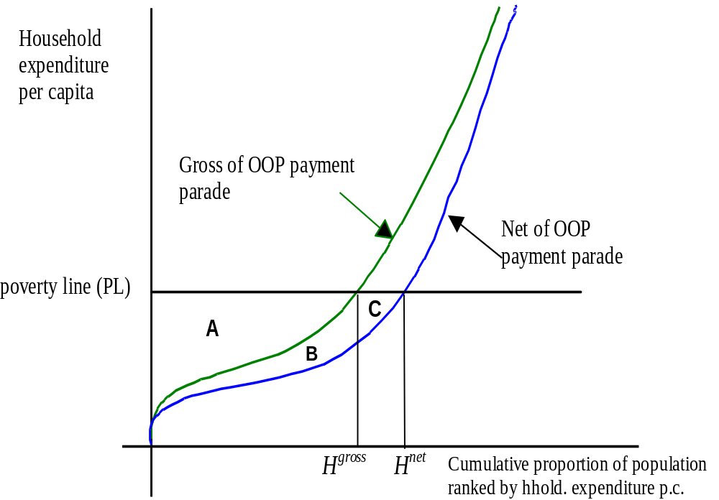
Health payments-adjusted poverty measures
Pen’s parade for household expenditure gross and net of
OOP health payments
Notes:
The Figure provides a simple framework for examining the impact of OOP payments on the two basic measures of poverty—the head count and the poverty gap. The figure is a variant on Jan Pen’s “parade of dwarfs and a few giants” (see, e.g., Cowell 1995). The two parades plot household expenditure gross and net of OOP payments on the y-axis against the cumulative proportion of individuals ranked by expenditure on the x-axis. For this stylized version of the graph, we assume that households keep the same rank in the gross and net of OOP expenditure distribution. Obviously, in reality rerankings will occur (see below). The point on the x-axis at which a curve crosses the poverty line (PL) gives the fraction of people living in poverty. This is the poverty head count ratio (H). This measure does not capture the “depth” of poverty, that is, the amount by which the poor households fall short of reaching the poverty line. A measure that does take that into account is the poverty gap (G), defined as the area below the poverty line but above the parade.
Using household expenditure gross of OOP payments for health care, the poverty head count is and the poverty gap is equal to the area A. If OOP payments are subtracted from household expenditure before poverty is assessed, then the head count and gap must both rise—to and A+B+C, respectively. So is the fraction of individuals that are not counted as poor despite their household resources net of spending on health care lying below the poverty line. The respective underestimate of the poverty gap is B+C. The poverty gap increases both because those already counted as poor appear even poorer once health payments are netted out of household resources (area B) and because some who were not counted as poor on the basis of gross expenditures are assessed as poor after OOP payments (area C) are taken into account.

Slide 5

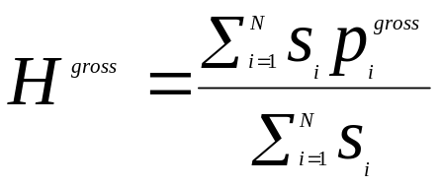

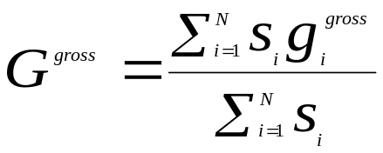

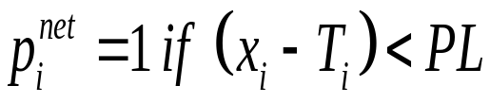

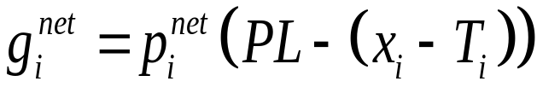
Poverty measures gross and net of health payments
Let x_{i} be total per capita hhold expenditure and
indicate whether the hhold is poor.
Gross of health payments poverty headcount is
Indv-level poverty gap is and the
gross of payments poverty gap is:
Net of payment headcount and gap given by replacing with
and with
Notes:
1() is the index function returning a value of 1 if the expression inside brackets is true and 0 otherwise.
s_i is the number of individuals in hhold . N is the numbner of hholds. PL is the poverty line. T_i is the OOP heaslth payments of hhold i.
For easier comparison, the poverty headount and gap can be normalised (divided by) on the poverty line.

Slide 6
Defining the poverty line
Absolute – a given level of hhold expenditure/income e.g. cost of satisfying subsistence nutritional requirements
Relative – fraction of mean/median expenditure/income
Using relative PL would amount to examining how OOP payments impact on distribution
Should the PL be adjusted downward? Yes if it allows for health care needs. But does it?
Given the heterogeneous and stochastic nature of health care needs, how can they be integrated into the PL?
Notes:
To compute poverty counts and gaps, a poverty line needs to be established. Poverty lines are either absolute or relative (Ravallion 1998). An absolute poverty line defines poverty in relation to an absolute amount of household expenditure per capita. An extreme absolute poverty line indicates the cost of reaching subsistence nutritional requirements (e.g., 2,100 calories a day) only. More generous poverty lines make some allowance for nonfood needs. A relative poverty line is defined as some fraction of mean or median household expenditure. If such a poverty line were used in the present context, basically the analysis would amount to consideration of how health payments affect the distribution of expenditure. This may be of some interest, but it is likely that primary interest lies in how taking health payments into account affects poverty assessed against an absolute standard.
It might be argued that if poverty is to be assessed on the basis of household expenditure net of OOP payments for health care, then the poverty line should also be adjusted downward. This would be correct if the poverty line allowed for resources required to cover health care needs. Poverty lines that indicate resources required to cover only subsistence food needs clearly do not. Higher poverty lines may make some indirect allowance for expected health care needs, but they can never fully reflect these needs, which are inherently highly variable, both across individuals and across time. A common procedure for constructing a poverty line involves calculating expenditure required to meet subsistence nutrition requirements and the addition of an allowance for nonfood needs (Deaton 1997). More directly, the mean total expenditure of households just satisfying their nutritional requirements may be used as the poverty line. Implicitly, this takes into account the expected spending on health care of those in the region of food poverty. But there will be tremendous variation across households in health status and therefore in their health care needs, which will not be reflected in the poverty line. This may be less of a problem in high-income countries, in which explicit income transfers exist to cover the living costs of disability. But such transfers seldom exist in low-income countries. Further, the health care needs of a given household are stochastic over time. A person falling seriously ill faces health care expenses well above the average. Meeting these expenses can easily force spending on other goods and services below the poverty threshold level.
So, there is no reason to adjust a subsistence food poverty line, but higher poverty lines may make some implicit allowance for expected health care needs and, in this case, it would make sense to adjust the poverty line downward when assessing poverty on expenditure net of health payments. One option is to adjust the poverty line downward by the mean health spending of households with total expenditure in the region of the poverty line (Wagstaff and van Doorslaer 2003). If that practice is adopted, then obviously some households who spend less on health care than this average can be drawn out of poverty when it is assessed on expenditure net of health care payments. That practice is not advisable if comparisons are being made across countries or time and the standard poverty line has not been adjusted to reflect differences in mean health payments in the region of food poverty. For example, the World Bank poverty lines of $1 or $2 per day clearly do not reflect differences across countries in poor households’ exposure to health payments. Subtracting country-specific means of health spending from these amounts would result in lower poverty lines, and so less poverty, in countries that protect low-income households the least from the cost of health care.

Slide 7
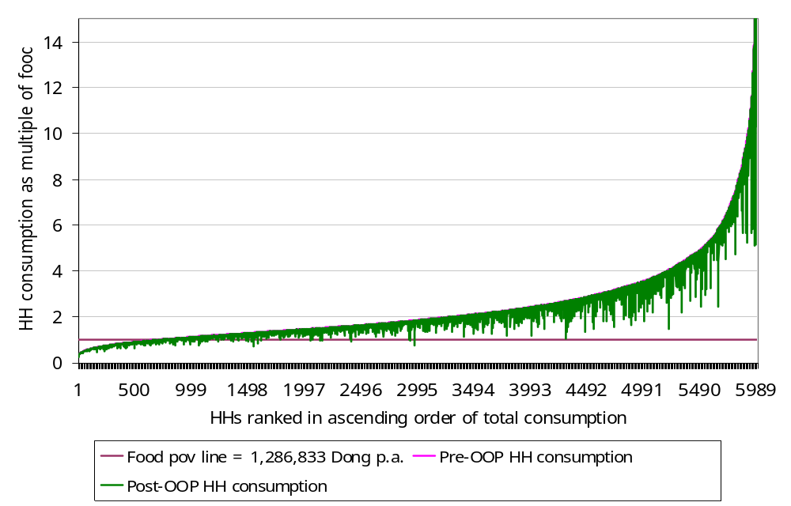
Effect of Health Payments on Pen’s Parade of the Household Consumption Distribution, Vietnam 1998
Notes:
The first figure presented on previous slide is a stylized version of the Pen Parade representation of the income distribution. When health payments produce reranking in the income distribution, it is still possible to visualize the effect of health care payments on the parade using what we refer to as a “paint drop” chart (Wagstaff and Van Doorslaer 2003). An example is given in the figure above for Vietnam in 1998. The graph shows the Pen Parade for household consumption gross of health payments. Household consumption is expressed here as multiples of a national extreme poverty line (PL) based on minimum food requirements, which is above the $1.08 threshold used by the World Bank. For each household, the vertical bar, or “paint drip,” shows the extent to which the subtraction of health payments reduces consumption. If a bar crosses the poverty line, then a household is not counted as poor on the basis of gross consumption but is poor on the basis of net consumption.
The graph shows that health payments are largest at higher values of total consumption, but it is households in the middle and lower half of the distribution that are brought below the poverty line by health payments.

Slide 8
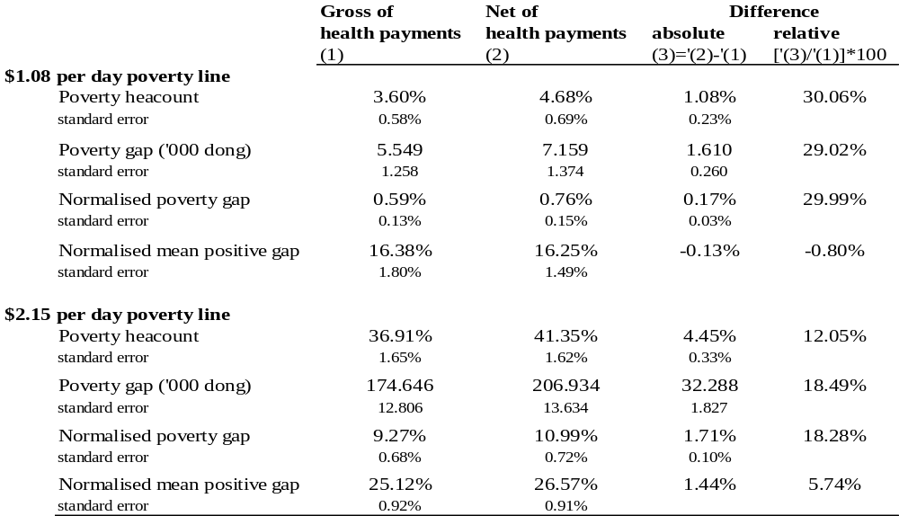
Health Payments–Adjusted Poverty Measures in Vietnam, 1998
Notes:
A demonstration of the sensitivity of poverty measures in Vietnam to the treatment of health payments is presented in the table below. The estimates are derived from the 1998 Vietnam Living Standards Survey and are taken from a study of the effect of health payments on the measurement of poverty in 11 Asian countries (van Doorslaer et al. 2006). Estimates are presented for the $1.08 and $2.15 per person per day poverty lines used by the World Bank for international poverty comparisons. The first of these is the poverty threshold used in the definition of the Millennium Development Goal with respect to extreme poverty. At the 1993 purchasing power parity exchange rate, the thresholds convert to 941,772 and 1,883,546 Vietnamese dong per year in 1998 prices. The living standards measure used is per capita household consumption. We do not adjust either poverty line when assessing poverty on the basis of household consumption net of health payments. The lower poverty line is sufficiently strict such that it would not cover even expected health care costs. The higher poverty line is not adjusted because the analysis was part of an international comparison and, as explained above, adjustment would have created perverse results across countries.
When assessed on the basis of total household consumption, 3.6 percent of the population of Vietnam is estimated to be in extreme poverty (<$1.08). If OOP payments for health care are netted out of household consumption, this percentage rises to 4.68 percent. So about 1 percent of the Vietnamese population is not counted as living in extreme poverty but would be considered poor if spending on health care is discounted from household resources. This represents a substantial rise of 30 percent in the estimate of extreme poverty. The estimate of the poverty gap also rises by almost 30 percent, from 5,549 dong to 7,159 dong. Expressed as a percentage of the poverty line, the poverty gap increases from 0.59 percent of the $10.08 line to 0.76 percent when health payments are netted out of household consumption. The mean positive poverty does not increase. It falls slightly. This suggests that the rise in the poverty gap is due to more households being brought into poverty (area C in figure 19.1) and not because of a deepening of the poverty of the already poor (area B in figure 19.1).
At the $2.15 per day poverty line, the pattern of results is the same, but the relative difference in poverty is less and the intensity of poverty, as measured by MPG, no longer falls when poverty is assessed on consumption net of health care costs.
Standard errors are small relative to the point estimates, and for all measures the difference in the estimate of poverty based on household consumption gross and net of health payments is statistically significantly different from zero at 5 percent or less.

Slide 9
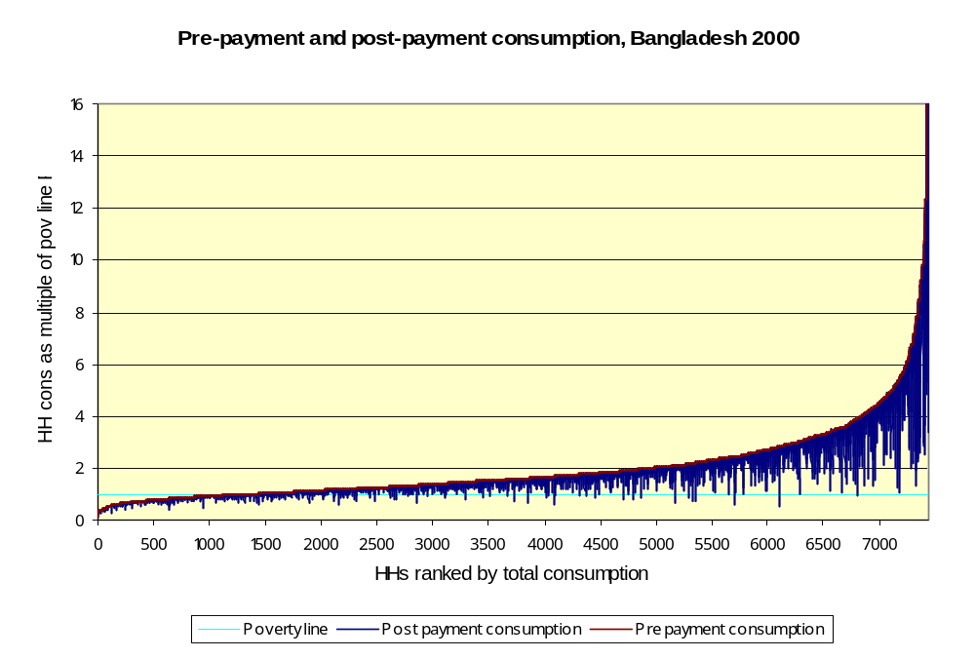
Effect of Health Payments on Pen’s Parade – Bangladesh, 2000 (PL=$1.08)
Notes:
1. Source: Equitap study – van Doorslaer, E., O. O’Donnell, R. P. Rannan-Eliya, A. Somanathan, S. R. Adhikari, D. Harbianto, C. G. Garg, A. N. Herrin, M. N. Huq, S. Ibragimova, A. Karan, C.-w. Ng, B. R. Pande, R. Racelis, S. Tao, K. Tin, L. Trisnantoro, C. Vasasvid, and Y. Zhao. 2006. “Effect of Health Payments on Poverty Estimates in 11 Countries in Asia: An Analysis of Household Survey Data.” The Lancet 368(14): 1357–64

Slide 10
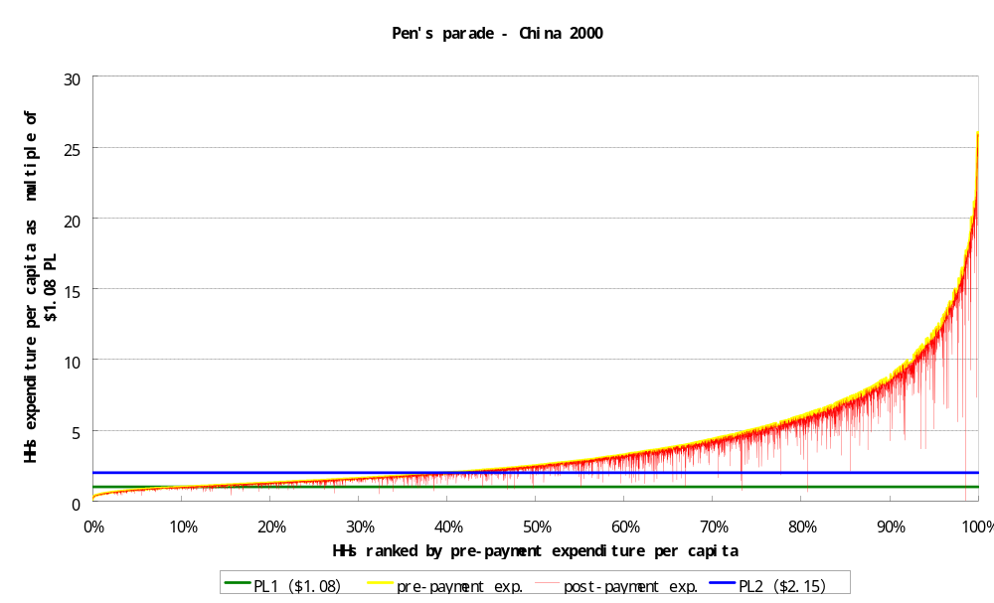
Effect of Health Payments on Pen’s Parade –China, 2000 (PL=$1.08, $2.15)

Slide 11
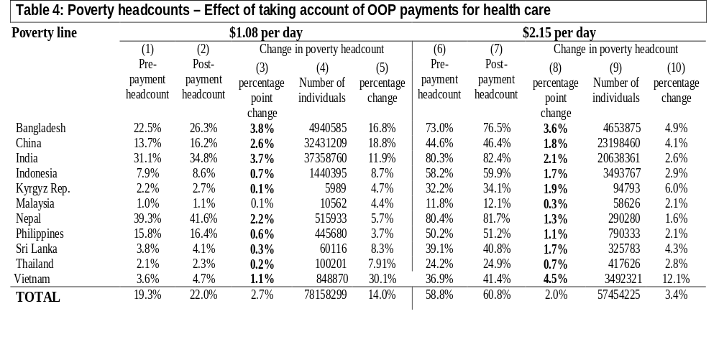
Health payments-adjusted poverty headcounts in Asia
Notes:
Van Doorslaer et al (2006)
At the $1 poverty line, the headcount increases from 19.3% of the population covered by these Asian countries to 22%. That is equivalent to 78 million more people recognised as living in poverty when their payments for health care are taken into account. It is a 14% increase in the rate of poverty.
Notes: Column (3)=(2)-(1). Column (4)=(3)*population. Column (5)=(3)/(1). Bold figures in columns (3) and (8) denote statistically significantly different from zero at the 5% significance level.

Slide 12
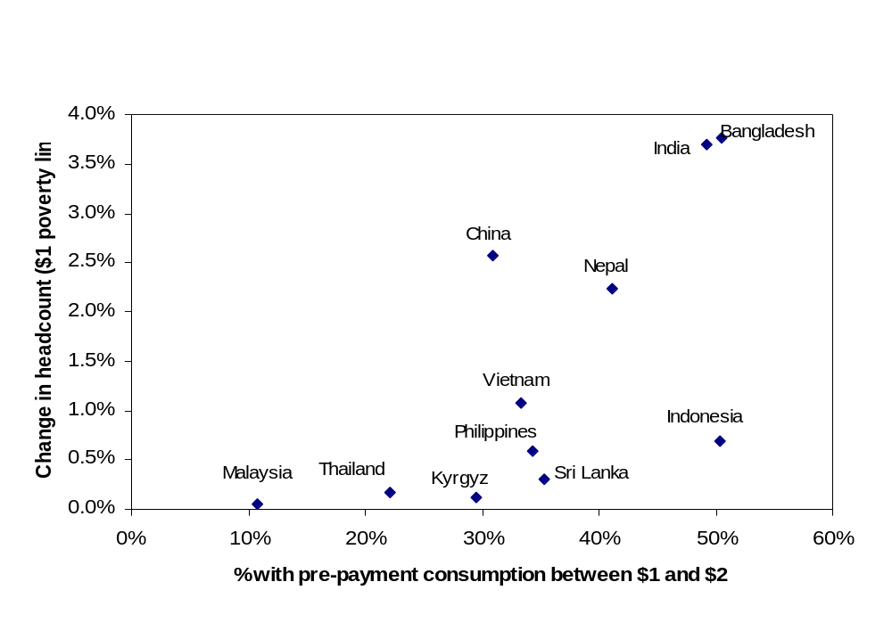
Adjustment to poverty headcount for health payments increases with population at risk
Notes:
Source is van Doorslaer et al (2006)
PL is $1.08.
Those at risk are defined as having consumption gross of health payments between $1 and $2 per day.

Slide 13
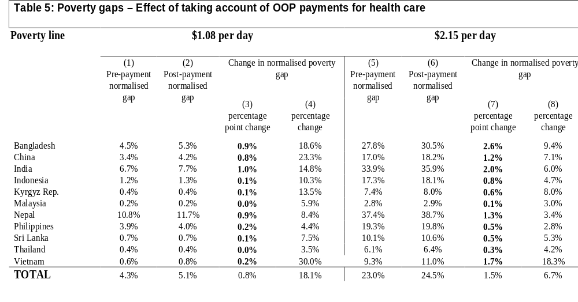
Health payments-adjusted poverty gaps in Asia

